Slide 1

AtliQ Mart Festive Promotions Analysis: Diwali 2023 and Sankranti 2024
Created by Sougat Dey

Slide 2
Table of Contents
Introduction of AtliQ Mart & Problem Statement
Power BI Dashboard
Promotion-level Analysis
Product-level Analysis
Store Level Analysis
Ad-hoc Request
Summary & Recommendations

Slide 3
About AtliQ Mart
AtliQ Mart is a retail giant with over 50 supermarkets in the southern region of India. All their 50 stores ran a massive promotion during the Diwali 2023 and Sankranti 2024 (festive time in India) on their AtliQ branded products.
Now the sales director wants to understand which promotions did well and which did not so that they can make informed decisions for their next promotional period.

Slide 4
Power BI Dashboard

Slide 5
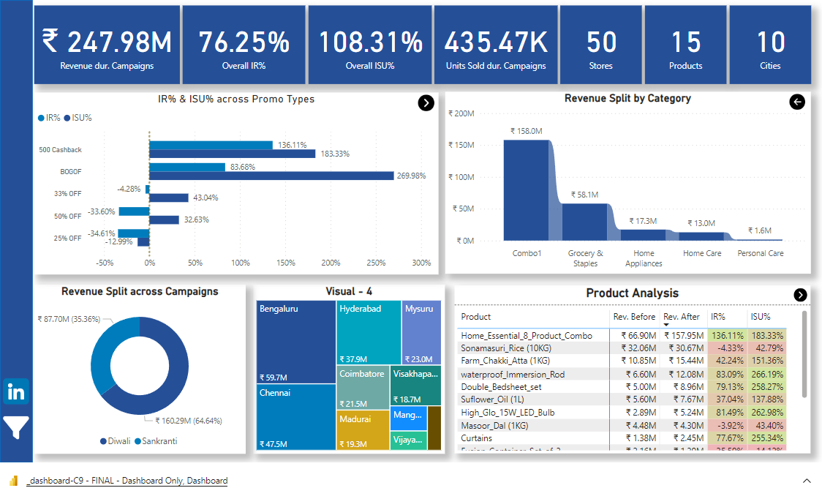

Slide 6
Promotion-level Analysis

Slide 7


Q1. How do two campaigns compare side-by-side?
The Sankranti campaign contributed to a notable increase in units sold; however, it was the Diwali campaign that propelled revenue to nearly double during its time.
Undoubtedly, the Diwali campaign played a pivotal role in bolstering the financial performance of the business, thereby yielding superior results when juxtaposed with the Sankranti campaign.

Slide 8
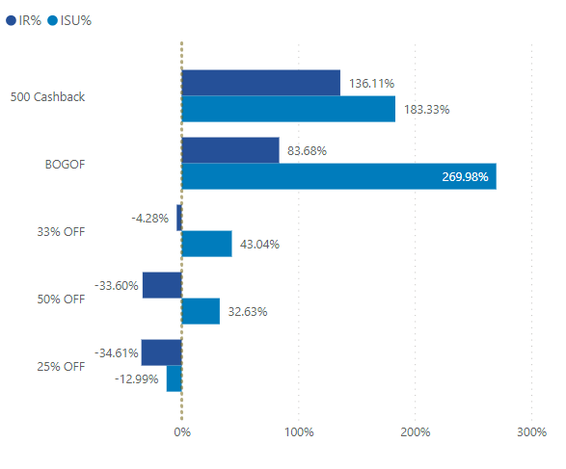
Q2. What are the top 2 promotion types that resulted in the highest Incremental Revenue?
In assessing the effectiveness of promotion types, it was observed that only '500 cashback' and 'BOGOF' initiatives generated positive incremental revenue.
Hence, '500 cashback' and 'BOGOF’ are the promotional types yielding the highest incremental revenue.

Slide 9
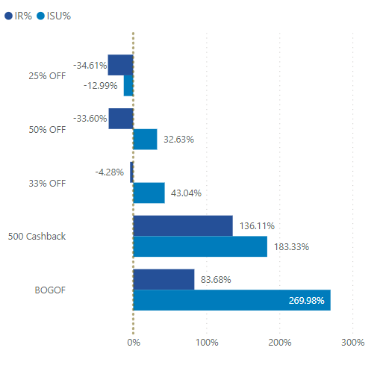
Q3. What are the bottom 2 promotion types in terms of their impact on Incremental Sold Units?
While the `25% OFF` promotion had adverse effects on the business, leading to a decrease in incremental units sold, the `50% OFF` promotion enabled a substantial increase in units sold by 32.63%

Slide 10
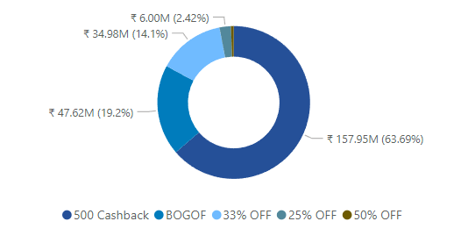
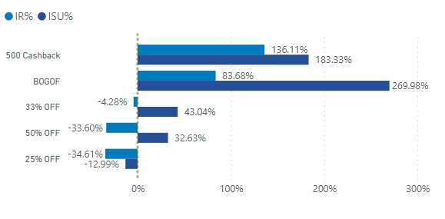
Q4. Is there a significant difference in the performance of discount-based promotions versus BOGOF or cashback promotions?
Despite being the third highest in terms of volume among the five promotion types, the product featured in the '500 Cashback' promotion garnered the highest revenue. This can be attributed to its significantly higher price compared to other products (being the costliest). Consequently, a substantial revenue gap exists between the '500 Cashback' promotion and other promotion types.

Slide 11
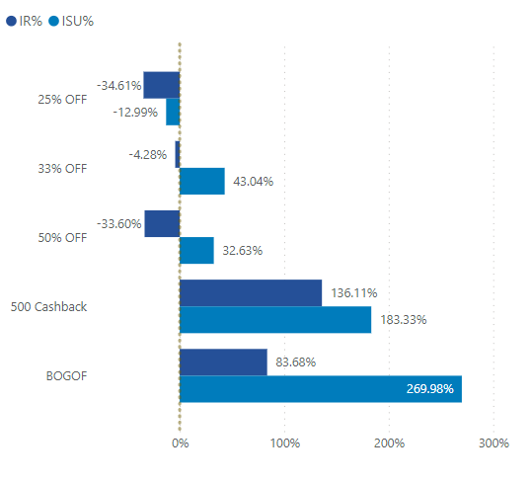
Q5. Which promotions strike the best balance between Incremental Sold Units and maintaining healthy margins?
As the objective of promotions is to enhance sales for the business, if the Incremental Sold Units (ISU) undergoes a significant increase without a proportional rise in Incremental Revenue (IR), it adversely affects the overall revenue.
Among the promotions assessed, '500 Cashback' stands out as the only one achieving a delicate equilibrium between increasing ISU while simultaneously maintaining healthy margins.

Slide 12
Product-level Analysis

Slide 13
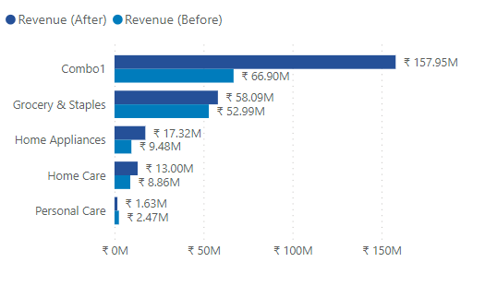
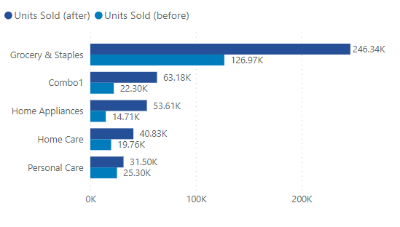
Q1. Which product categories saw the most significant lift in sales from the promotions?
The `Combo1` category experienced a significant surge in sales, nearly tripling the units sold and increasing revenue by almost 2.5 times, owing to the `500 Cashback` promotion. Following closely behind is the `Grocery and Staples` category, which also exhibited considerable sales growth.

Slide 14
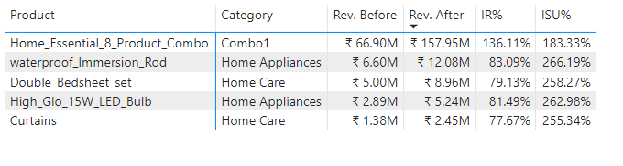
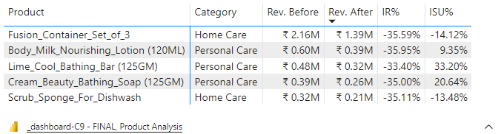
Q2. Are there specific products that respond exceptionally well or poorly to promotions?
Product that responded exceptionally well
Product that responded exceptionally poorly

Slide 15
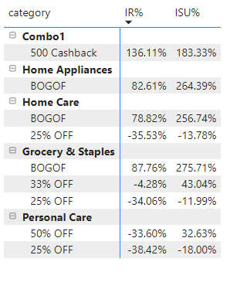
Q2. What is the correlation between product category and promotion type effectiveness?
In all three offered categories, `BOGOF` demonstrated strong performance, whereas `25% OFF` consistently underperformed even impacted the business to some extent.
The promotion `500 Cashback` emerged as the most successful among them.

Slide 16
Store-level Analysis

Slide 17
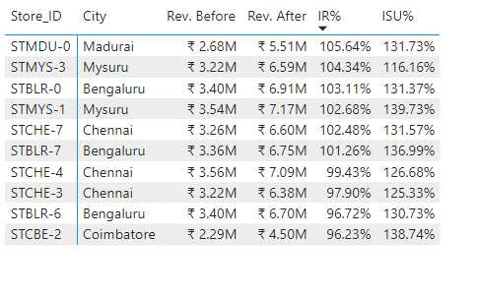
Q1. Which are the top 10 stores in terms of Incremental Revenue (IR) generated from the promotions?

Slide 18
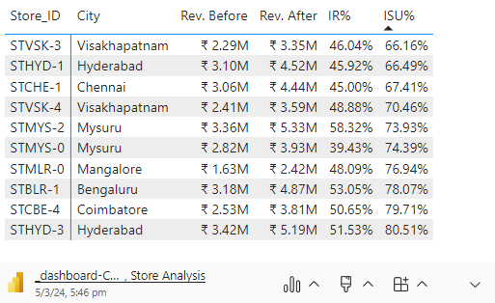
Q2. Which are the bottom 10 stores when it comes to Incremental Sold Units (ISU) during the promotional period?

Slide 19
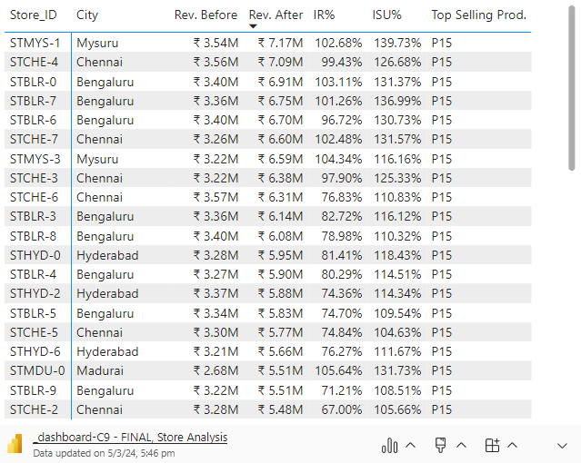
Q3. How does the performance of stores vary by city? Are there any common characteristics among the top performing stores that could be leveraged across other stores?
Despite the top-selling product across all stores being the 'Combo1' (P15), the stores located in Mysore, Chennai, and Bangalore are predominantly driving the majority of sales.

Slide 20
Ad-hoc Analysis

Slide 21
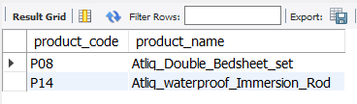
1. Provide a list of products with a base price greater than 500 and that are featured in promo type of 'BOGOF' (Buy One Get One Free). This information will help us identify high-value products that are currently being heavily discounted, which can be useful for evaluating our pricing and promotion strategies.

Slide 22
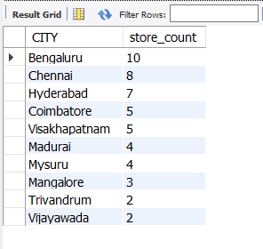
2. Generate a report that provides an overview of the number of stores in each city. The results will be sorted in descending order of store counts, allowing us to identify the cities with the highest store presence. The report includes two essential fields: city and store count, which will assist in optimizing our retail operations.

Slide 23
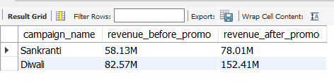
3. Generate a report that displays each campaign along with the total revenue generated before and after the campaign? The report includes three key fields: campaign_name, totaI_revenue(before_promotion), totaI_revenue(after_promotion). This report should help in evaluating the financial impact of our promotional campaigns. (Display the values in millions)

Slide 24
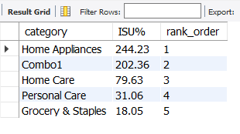
4. Produce a report that calculates the Incremental Sold Quantity (ISU%) for each category during the Diwali campaign. Additionally, provide rankings for the categories based on their ISU%. The report will include three key fields: category, ISU%, and rank order. This information will assist in assessing the category-wise success and impact of the Diwali campaign on incremental sales.

Slide 25
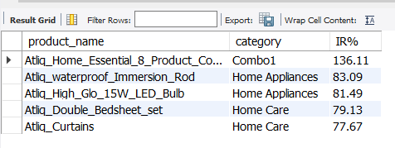
5. Create a report featuring the Top 5 products, ranked by Incremental Revenue Percentage (IR%), across all campaigns. The report will provide essential information including product name, category, and IR%. This analysis helps identify the most successful products in terms of incremental revenue across our campaigns, assisting in product optimization.

Slide 26
Summary of Findings
Revenue After Promo Split
- Diwali 2023: ₹160 million
- Sankranti 2024: ₹88 million
Top Performing Promotions:
- `500 Cashback`: Highest revenue generator
- `BOGOF` (Buy One Get One Free): Second highest revenue generator
Regional Dominance:
- Stores in Mysore, Bangalore, and Chennai dominated sales.
Product Performance:
- `Combo1` generated highest revenue due to 500 Cashback promotion.
- 25% OFF promotion resulted in negative impact on sales.
Promotion Impact:
- Only `500 Cashback` and `BOGOF` had positive impact on both Increase in Revenue Percentage (IR%) and Increase in Sales Units Percentage (ISU%).
Category Performance:
- `Combo1` and `Grocery and Staples` performed well compared to other categories.
- `Scrub Sponge for Dishwash` performed the worst in both IR% and ISU%.

Slide 27
Recommendations
- Focus on `500 Cashback` and `BOGOF` promotions for future campaigns.
- Evaluate regional performance and consider allocating resources accordingly.
- Review product pricing strategy, especially for high-cost items like `Combo1`.
- Avoid `25% OFF` promotion or reassess its implementation strategy on some categories.
- Invest in promoting categories with higher performance, such as `Combo1` and `Grocery and Staples`.
- Conduct a thorough analysis to understand reasons behind poor performance of products like `Scrub Sponge for Dishwash` and take corrective actions.

Slide 28

THANK YOU

